Slide 1
Mid-Year Orientation
Notes:
Ask students introduce themselves with things like name, age, where they are from, and where they attend school.
What do YOU hope to get out of this?
What do you think we will discuss?
What do you want to talk about -- anything specific about your experiences so far?

Slide 2
Objectives
By the end of the webinar, you will be able to:
Energize your commitment to a positive exchange experience.
Discuss the challenges of your exchange and develop solutions.
Look forward to the remainder of your experience and develop plans and strategies to continue personal growth.
Apply new skills and knowledge as a global citizen.
Notes:
Review the objectives- make sure the student understands the meaning of the words, simplify as needed.- Ask students to read these and ask them to explain what they think each objective means and why it is relevant.
Tell them during this orientation…
We will go on a time travel and create an adjustment curve to discuss the challenges of the exchange.
Talk for a few minutes about problem solving to share a few ways to make good choices and develop solutions if problems arise.
Discuss stereotypes and why stereotyping is not good.
Review communication styles and talk about how to make American friends
Set some goals and talk about steps you can take to become a global citizen to get the most out of your exchange experience!

Slide 3
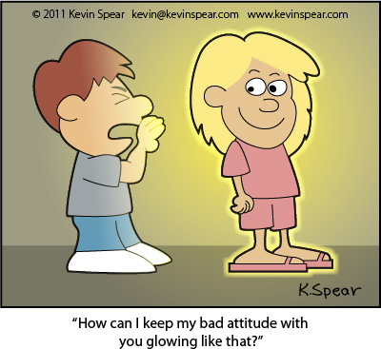
“Attitude is a little thing that makes a big difference.”
Winston Churchill

Slide 4
The Adjustment Process
Notes:
Session # 2- Adjustment Process---see curriculum
Now, we want to take the students through a brief “time travel” to help them reflect, discuss, and share where they are in their adjustment process in their exchange experience

Slide 5
Time Travel
Notes:
We want students to re-experience some of the moments that they have had on their exchange thus far. Ask students to listen closely and visualize the different situations. Explain that they are going on a “time travel” to relive some of their first experiences when they arrived in the US?

Slide 6
Adjustment Curve
Think about your time here again and try to
remember the highs and lows.
Awesome Sauce 10
(Very Happy) 9
Smiley Face 8
(Happy) 7
Meh 6
(Normal) 5
Bummer 4
(Unhappy) 3
Pull Covers Over Head 2
Very Unhappy 1
2
1
Notes:
Ask the students to describe what the graphic is showing. If they cannot figure it out, show them how the y axis shows happiness, and the x marks time.
Tell the students to think about their YFU journey thus far.

Slide 7
Sample Adjustment Curve
Notes:
Tell students that the will now plot their own adjustment curves. Explain that they need to think back month by month on how they were feeling throughout their exchange

Slide 8
Adjustment Curve Discussion
Highs and lows?
Favorite thing about exchange so far? Why?
How about a moment that was low?
Is there anything that could have made that moment better?
Notes:
Let the students know that there is no wrong adjustment curve, different people have different experiences. No two adjustment curves will look the same.
Ask students to talk a little about their adjustment curve. Use the prompts above:
As students share be sure to highlight the following points:
Each exchange experience is unique and equally valuable.
Students need to understand where they fit emotionally in the adjustment process at this point.
Students should understand the importance of their own attitudes towards the exchange experience.

Slide 9
“The remarkable thing is we have a choice every day regarding the attitude we will embrace for that day. We cannot change the past... we cannot change the fact that people act a certain way. We cannot change the inevitable. The only thing we can do is play on the one string we have, and that is our attitude...”
-Charles Swindoll
Notes:
Ask the students to look at the slide and ask someone to read the quote aloud.
Ask students why this quote is relevant.

Slide 10
Dear Area
Representative
Notes:
Now we’re going to help each other problem solve some scenarios on the next few slides.

Slide 11
Problem Solving Questions
What are some ways to improve this situation/issue?
Who is someone that you could talk to in this situation?
Has anyone experienced this problem and figured out a solution?
What are some things that you wouldn’t want to do in this situation?

Slide 12
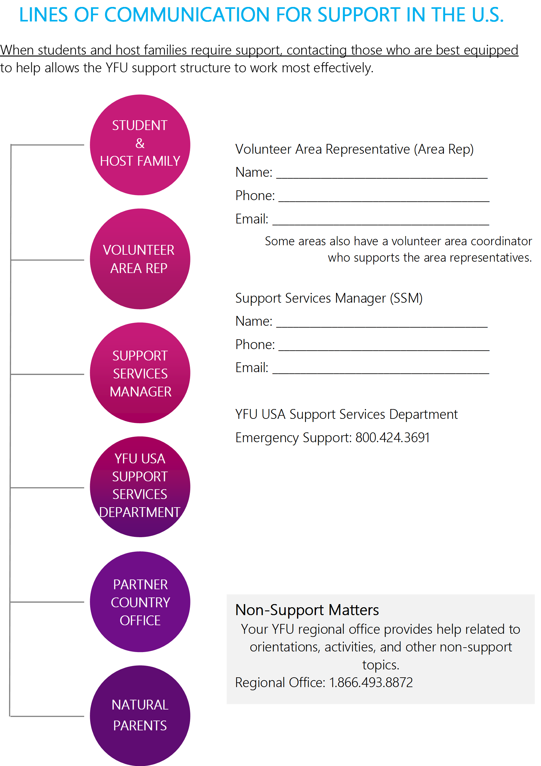
YFU Support
Who is your
Area Representative?
Notes:
Go through support structure for YFU. Make sure the student knows the name and contact information for his/her Area Representative.
Ask if students have been hearing from their AR. If a student has not heard form their AR or does not know who there are is- be sure to let YFU know about this case.

Slide 13
Stereotyping
Notes:
Session #4- Stereotyping
See curriculum

Slide 14
Communication
Notes:
Session # 5- see curriculum

Slide 15
Goal Setting
Notes:
Session # 6- Goal Setting

Slide 16
Goals
List at least three goals for the remainder of the exchange and list a concern on the other side.
Think about why you came on exchange.
Would anyone like to share…….

Slide 17
Wrap Up Reviewing Objectives
Did we-
Energize your commitment to a positive exchange experience.
Discuss the challenges of your exchange and develop solutions.
Look forward to the remainder of your experience and develop plans and strategies to continue personal growth.
Apply new skills and knowledge as a global citizen
Notes:
Session # 7- Wrap UP
Review objectives and ask students if we reached each objective and how it was achieved?

Slide 18
“Twenty years from now you will be
more disappointed by the things you
didn't do than by the ones you did do.
So throw off the bowlines.
Sail away from the safe harbor.
Catch the wind in your sails.
Explore. Dream. Discover.”
~Mark Twain
(b. 1835 - d.1910)
Notes:
Read the quote or ask a student to read it and share their thoughts
Samuel Langhorne Clemens, better known by his pen name Mark Twain, was an American author and humorist. He wrote The Adventures of Tom Sawyer and its sequel, Adventures of Huckleberry Finn, the latter often called "The Great American Novel".
Born: November 30, 1835, Florida, MO
Died: April 21, 1910, Redding, CT

