Slide 1
Study Abroad Interview Training

Slide 2
STUDY ABROAD INTERVIEWS
Purpose: learn more about the applicant and provide information to help the host country match the student with a host family
Interview questions and interviewer assessment
Interview score
Total score = Interview + essays + Teacher Recommendation

Slide 3
GENERAL TIPS
Where should the interview take place?
Ask follow-up questions
Complete the report in first or third person
What about parents?

Slide 4
What personality characteristics should an adolescent possess to be effective in a cross-cultural exchange?

Slide 5
ABILITY TO COPE WITH FAILURE
Perseverance
Persistence
Can deal with difficult situations
Has coping mechanisms
Gives up easily
Cannot imagine failing
Blames others
Has never made a mistake

Slide 6
COMMUNICATIVENESS
Expresses thoughts and feelings
Able to ask for help
Engaged
Timid
Overly shy/bashful
Unexpressive

Slide 7
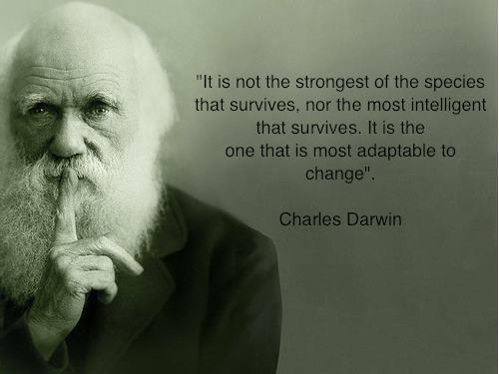
FLEXIBILITY/ADAPTABILITY
Adjusts to different situations
Willing to give up some customs/habits for new culture
Will try new unfamiliar activities, customs
Rigid
Uncompromising
Fussy/Particular
Unable to adjust

Slide 8
POSITIVE REGARD FOR OTHERS
Expresses warmth, empathy, respect
Concern for others
Kind, friendly
Disrespectful
Rude
Unfriendly
Lacks concern for others

Slide 9
REALISTIC EXPECTATIONS
Understands that exchange WILL be difficult at times
Expects differences from the US
Unrealistic expectations
Expects no difficulties
Predefined expectations about host family, school, travel opportunities, etc.

Slide 10
SENSE OF HUMOR
Laughs things off
Doesn’t take things too seriously

Slide 11
OPEN-MINDEDNESS
Flexible
Willing to understand and appreciate other values and beliefs
Receptive to new ideas
Unprejudiced and impartial
Rigid
Uncompromising
Unyielding

Slide 12
SENSE OF SELF
Clear, secure feelings about self
Stands up for beliefs
Self confident and self assured
Self reliant
Calm, composed, mature
Overly confident
Arrogant/conceited
Self-centered

Slide 13
CURIOSITY
Eager to learn
Inquisitive
Interested in learning about the host country
Indifferent
Not interested in learning about other people, places, etc.

Slide 14
TOLERANCE FOR DIFFERENCES
Security in the midst of difference
Accepting/supportive of other viewpoints
Fair, objective, impartial, non-judgmental
Rigid, intolerant
Disapproving
Judgmental
Opinionated
Disdainful of other viewpoints

Slide 15
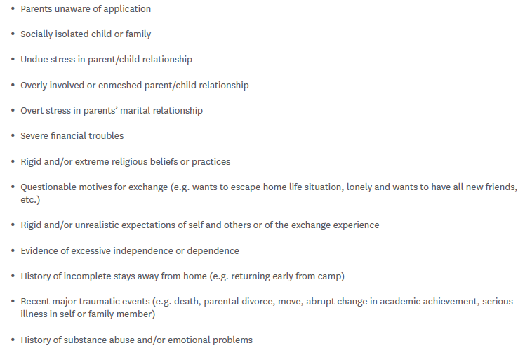
WARNING INDICATORS

Slide 16
FOR MORE INFORMATION…
The full interview packet with directions is available on the my.yfu Volunteer Lounge under “Interview Packet.”
The interview questions and report alone are available on the my.yfu Volunteer Lounge under “Interview Only.”

Slide 17
Questions?

